Slide 1
Principal Component Analysis

Slide 2
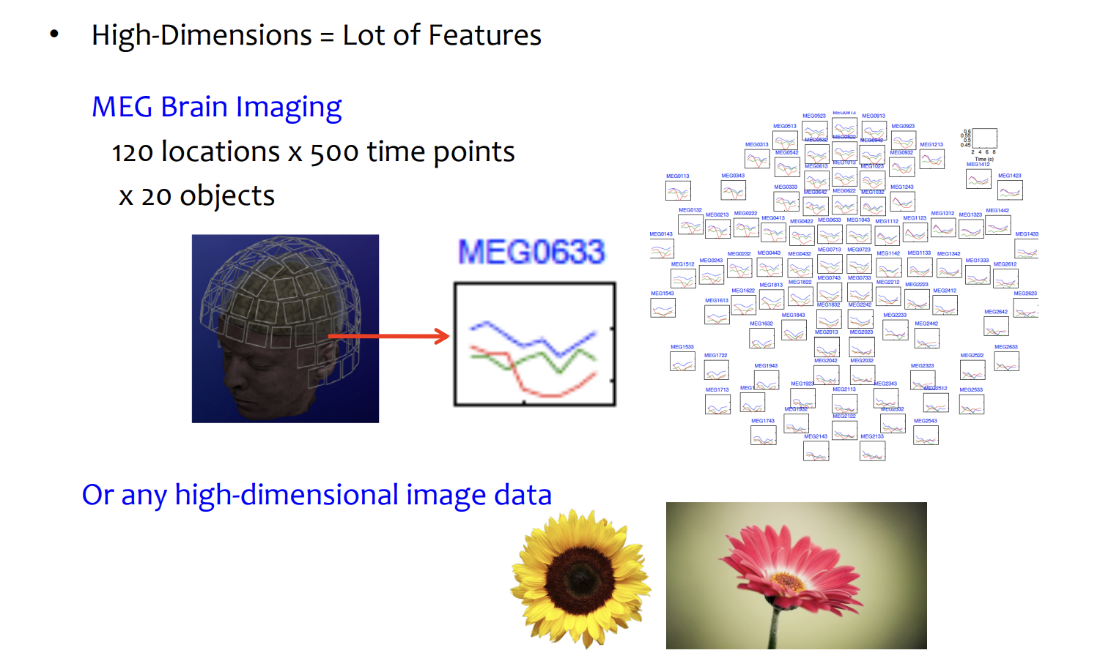
High Dimensional Data

Slide 3
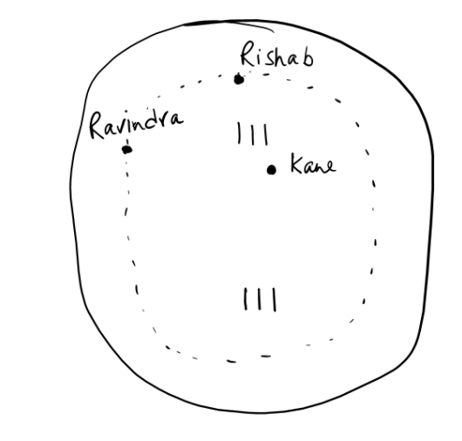
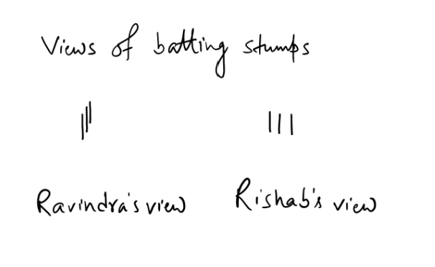
For a given set of data points in a d-dimensional space, it finds the directions along which the data can be seen more clearly.

Slide 4
Principal Components Analysis Ideas (PCA)
Does the data set ‘span’ the whole of d dimensional space?
Transform some large number of variables into a smaller number of uncorrelated variables called principal components (PCs).
PCA is developed to capture as much of the variation in data as possible
An exploratory technique used to reduce the dimensionality of the data set to 2D or 3D
Can be used to:
Reduce number of dimensions in data
Find patterns in high-dimensional data
Visualize data of high dimensionality

Slide 5
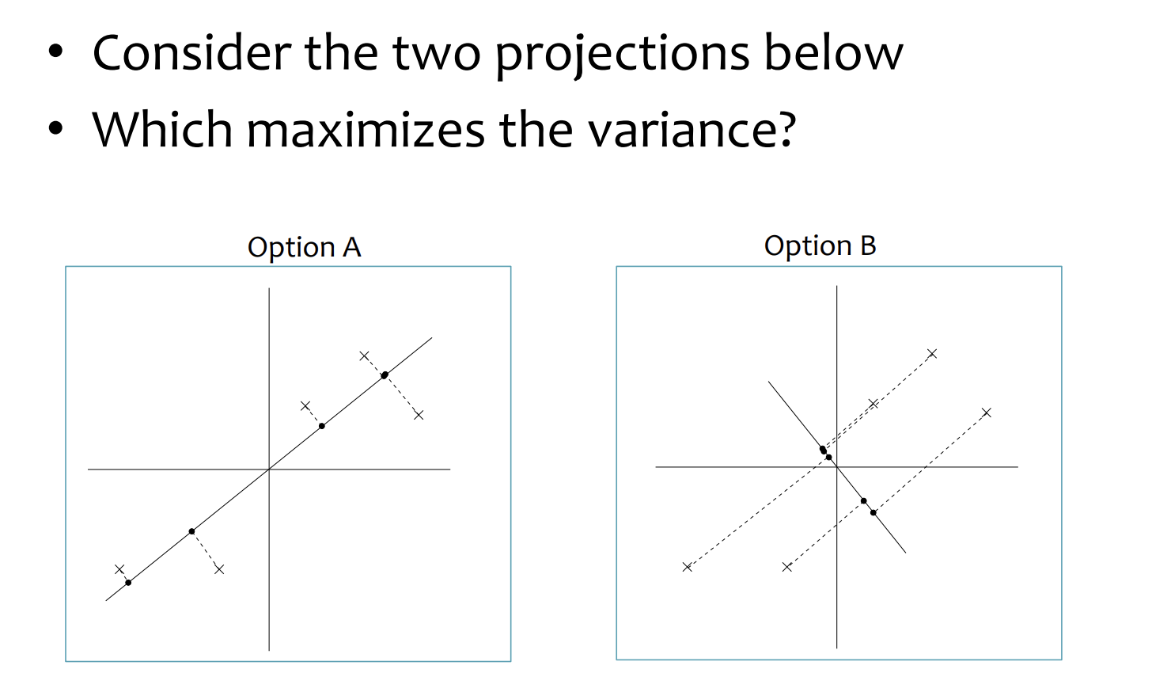
Maximizing the variance

Slide 6
Principal Component Analysis: one attribute first
Temperature
42
40
24
30
15
18
15
30
15
30
35
30
40
30
Question: how much spread is in the data along the axis? (distance to the mean)
Variance=Standard deviation^2

Slide 7
Now consider two dimensions
X=Temperature | Y=Humidity
40 | 90
40 | 90
40 | 90
30 | 90
15 | 70
15 | 70
15 | 70
30 | 90
15 | 70
30 | 70
30 | 70
30 | 90
40 | 70
30 | 90
Covariance: measures the correlation between X and Y
Cov(X,Y)=0: independent
Cov(X,Y)>0: move same dir
Cov(X,Y)<0: move oppo dir

Slide 8
More than two attributes: covariance matrix
Contains covariance values between all possible dimensions (=attributes):
Example for three attributes (x,y,z):

Slide 9


















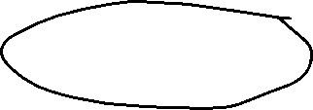








Eigenvalues & eigenvectors
Vectors x having the same direction as Ax are called eigenvectors of A (A is an n by n matrix).
In the equation Ax=λx, λ is called an eigenvalue of A.
Prof. Gilbert Strang from MIT
Linear Algebra (Eigenvalues and eigenvectors)

Slide 10










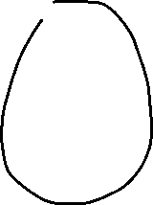







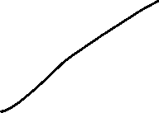
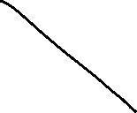












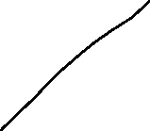


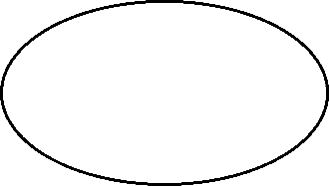
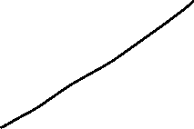



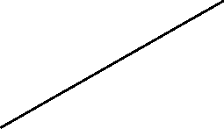
















Slide 11
Principal components
1st principal component (PC1)
The eigenvalue with the largest absolute value will indicate that the data have the largest variance along its eigenvector, the direction along which there is the greatest variation
2nd principal component (PC2)
The direction with maximum variation left in data, orthogonal to the 1st PC
In general, only a few directions manage to capture most of the variability in the data.

Slide 12
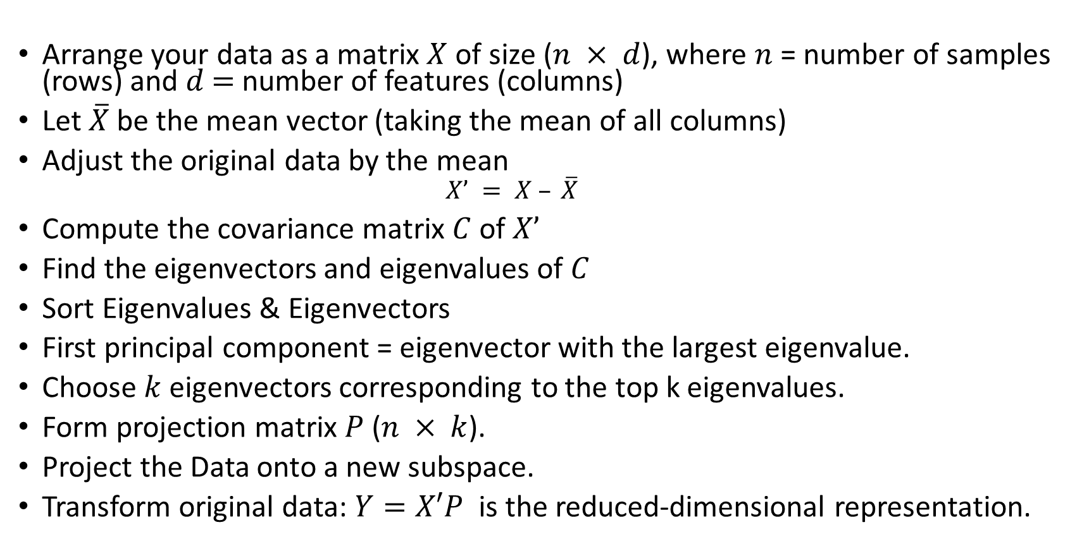
Steps of PCA
Arrange your data as a matrix $X$ of size ($n × d$), where $n$ = number of samples (rows) and $d$ $=$ number of features (columns)
Let $\overline{X}$be the mean vector (taking the mean of all columns)
Adjust the original data by the mean
$$X’ = X – \overline{X}$$
Compute the covariance matrix $C$ of $X’$
Find the eigenvectors and eigenvalues of $C$
Sort Eigenvalues & Eigenvectors
First principal component = eigenvector with the largest eigenvalue.
Choose $k$ eigenvectors corresponding to the top k eigenvalues.
Form projection matrix $P$ ($n × k$).
Project the Data onto a new subspace.
Transform original data: $Y=X′P$is the reduced-dimensional representation.

Slide 13
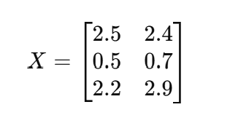
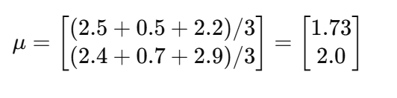
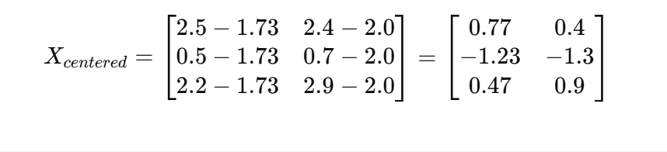
Dataset
Example
Suppose we have 3 data points (2 features)
Mean Centering

Slide 14
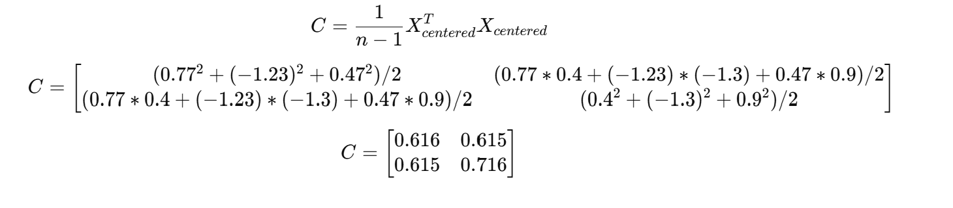
Covariance Matrix

Slide 15
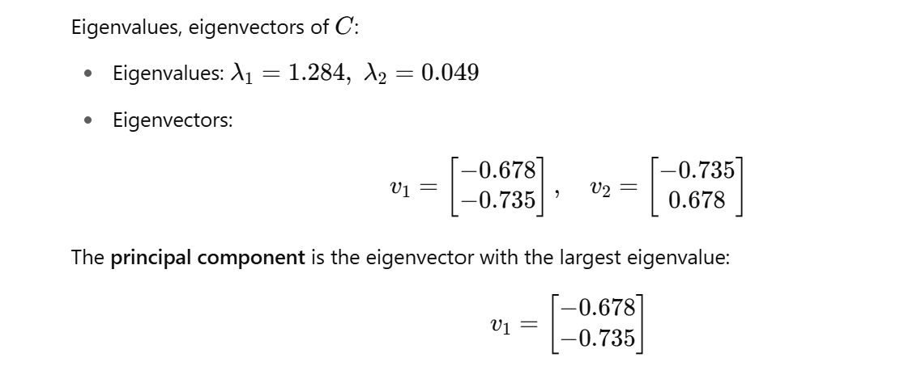
Eigen Decomposition

Slide 16
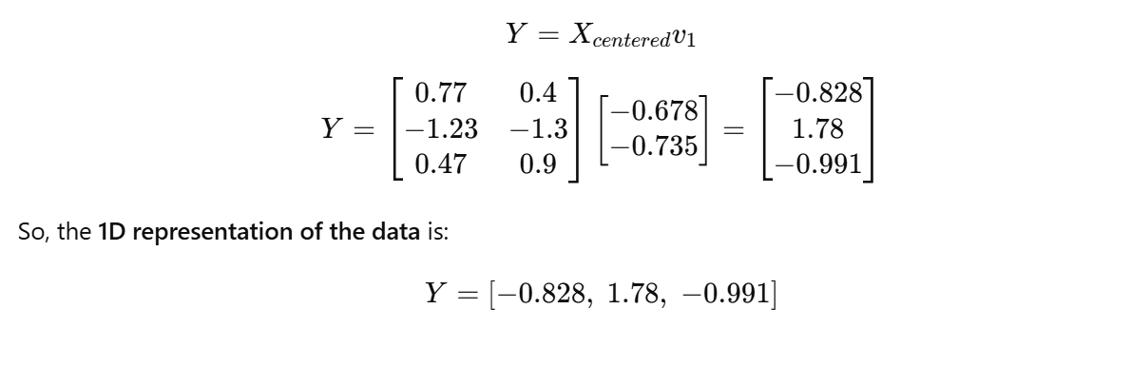
Project Data onto Principal Component

Slide 17
Principal components - Variance

Slide 18
PCA –> Original Data
Retrieving old data (e.g. in data compression)
RetrievedRowData=(RowFeatureVector^{T} x FinalData)+OriginalMean
Yields original data using the chosen components

Slide 19
Principal components
General about principal components
summary variables
linear combinations of the original variables
uncorrelated with each other
capture as much of the original variance as possible

